Slide 1
Instruction Pipeline and Hazards

Slide 2
The time delay of a 4-segment pipeline in different segments are t1=35 ns, t2 = 30 ns, t3 = 40 ns, t4=45 ns. The interface register delay time is t=5 ns. How long would it take to complete 100 instructions in the pipeline? (Assume there is no dependency between the instructions).

Slide 3
The time delay of a 4-segment pipeline in different segments are t1=35 ns, t2 = 30 ns, t3 = 40 ns, t4=45 ns. The interface register delay time is t=5 ns. How long would it take to complete 100 instructions in the pipeline? (Assume there is no dependency between the instructions).
t1 = 35
5
t2 = 30
5
t3 = 40
5
t4 = 45
5
delay
delay
delay
delay

Slide 4
Pipeline Cycle Time: The cycle time is based on the slowest segment (45 ns) plus the register delay (5 ns), resulting in a (45ns+5ns)50ns cycle.
Total Cycles Needed: For 100 instructions in a 4-segment pipeline, the total cycles are k+(n−1) = 4+(100−1)=103 cycles.
Total Execution Time: 103 cycles×50 ns/cycle=5150 ns.
So it takes 5150 ns to complete 100 instructions in pipeline.
Ins | 1 | 2 | 3 | 4 | 5 | 6 | 7 | 8 | 9 | 10
1 | S1 | S2 | S3 | S4
2 |  | S1 | S2 | S3 | S4
3 |  |  | S1 | S2 | S3 | S4
4 |  |  |  | S1 | S2 | S3 | S4

Slide 5
Which of the following statements is/are TRUE?
RAW data hazard could be reduced by operand forwarding.
A normal in-order 5 stage MIPS pipeline can achieve an IPC larger than 1.
For a MIPS instruction STR R2, 16(R3), some contents stored in its ID/EX pipeline register will bypass the EX unit directly to EX/MEM pipeline register.
A normal 5 stage in order RISC pipeline without operand forwarding can have RAW and WAR hazards.
(I) a only (II) a & c only (III) b & d only (IV) c & d only

Slide 6
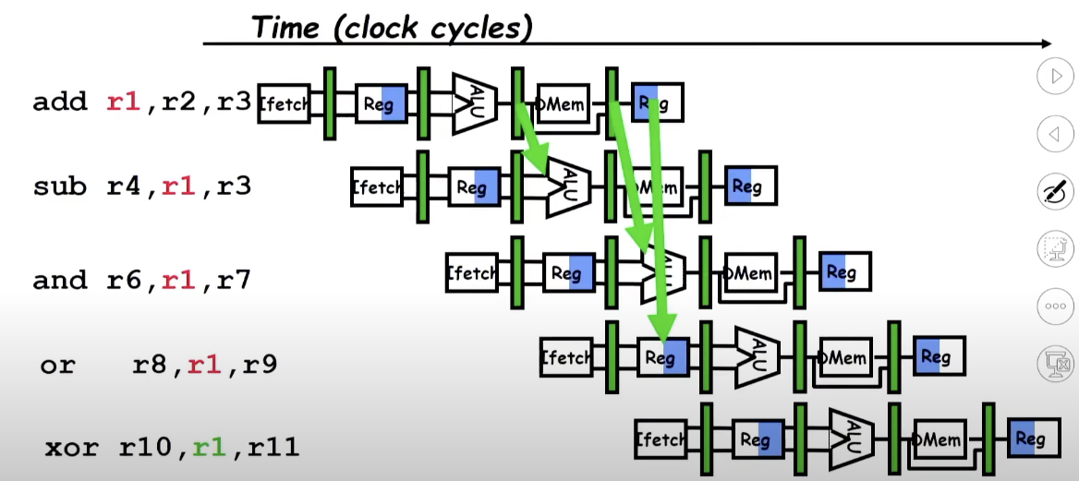
(I) RAW data hazard could be reduced by operand forwarding:

Slide 7
(I) RAW data hazard could be reduced by operand forwarding: TRUE

Slide 8
(II) A normal in-order 5 stage MIPS pipeline can achieve an IPC larger than 1:
Instruction number | 1 | 2 | 3 | 4 | 5 | 6 | 7 | 8 | 9
i | IF | ID | EX | MEM | WB
i + 1 |  | IF | ID | EX | MEM | WB
i + 2 |  |  | IF | ID | EX | MEM | WB
i + 3 |  |  |  | IF | ID | EX | MEM | WB
i + 4 |  |  |  |  | IF | ID | EX | MEM | WB

Slide 9
(II) A normal in-order 5 stage MIPS pipeline can achieve an IPC larger than 1: FALSE
IPC > 1 means we should be able to complete more than one instruction per clock cycle which is impossible in this case.
Instruction number | 1 | 2 | 3 | 4 | 5 | 6 | 7 | 8 | 9
i | IF | ID | EX | MEM | WB
i + 1 |  | IF | ID | EX | MEM | WB
i + 2 |  |  | IF | ID | EX | MEM | WB
i + 3 |  |  |  | IF | ID | EX | MEM | WB
i + 4 |  |  |  |  | IF | ID | EX | MEM | WB

Slide 10
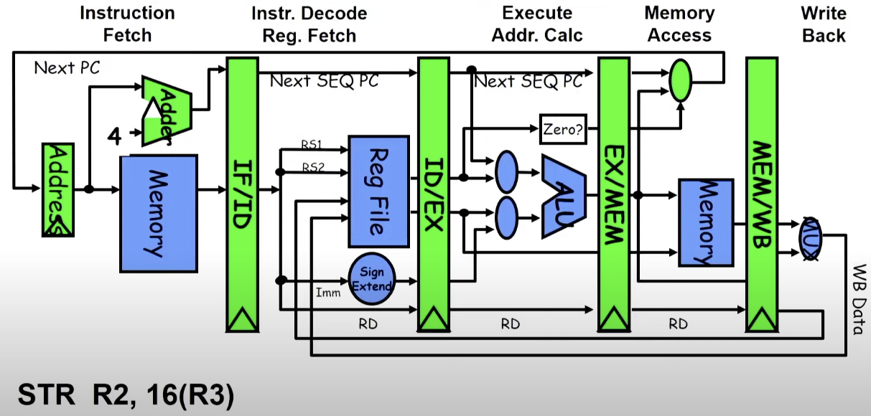
(III) For a MIPS instruction STR R2, 16(R3), some contents stored in its ID/EX pipeline register will bypass the EX unit directly to EX/MEM pipeline register:
Pipeline RISC Data Path (5 stage)

Slide 11
(III) For a MIPS instruction STR R2, 16(R3), some contents stored in its ID/EX pipeline register will bypass the EX unit directly to EX/MEM pipeline register: TRUE Reason: The ALU will compute only 16 + R3 and we need the value of R2 only in MEM stage hence the value of R2 will bypass EX unit i.e. from ID/EX to EX/MEM pipeline register.
Pipeline RISC Data Path (5 stage)

Slide 12
(IV) A normal 5 stage in order RISC pipeline without operand forwarding can have RAW and WAR hazards:
Instruction number | 1 | 2 | 3 | 4 | 5 | 6 | 7 | 8 | 9
i | IF | ID | EX | MEM | WB
i + 1 |  | IF | ID | EX | MEM | WB
i + 2 |  |  | IF | ID | EX | MEM | WB
i + 3 |  |  |  | IF | ID | EX | MEM | WB
i + 4 |  |  |  |  | IF | ID | EX | MEM | WB
add r1, r2, r3
sub r4, r1, r3
sub r4, r1, r3
add r1, r2, r3
sub r3, r1, r4
and r4, r1, r7

Slide 13
(IV) A normal 5 stage in order RISC pipeline without operand forwarding can have RAW and WAR hazards: FALSE RAW hazard may occur but WAR cannot occur in in-order execution
Instruction number | 1 | 2 | 3 | 4 | 5 | 6 | 7 | 8 | 9
i | IF | ID | EX | MEM | WB
i + 1 |  | IF | ID | EX | MEM | WB
i + 2 |  |  | IF | ID | EX | MEM | WB
i + 3 |  |  |  | IF | ID | EX | MEM | WB
i + 4 |  |  |  |  | IF | ID | EX | MEM | WB
add r1, r2, r3
sub r4, r1, r3
sub r4, r1, r3
add r1, r2, r3
sub r3, r1, r4
and r4, r1, r7

Slide 14
Which of the following statements is/are TRUE?
RAW data hazard could be reduced by operand forwarding.
A normal in-order 5 stage MIPS pipeline can achieve an IPC larger than 1.
For a MIPS instruction STR R2, 16(R3), some contents stored in its ID/EX pipeline register will bypass the EX unit directly to EX/MEM pipeline register.
A normal 5 stage in order RISC pipeline without operand forwarding can have RAW and WAR hazards.
(I) a only (II) a & c only (III) b & d only (IV) c & d only

Slide 15
Given a non-pipelined architecture running at 1GHz, that takes 5 cycle to finish an instruction. It was later converted to a 5 stage pipeline operating at 800MHz. A stall of 70 cycles happens in 2% of the memory instructions and a stall of 2 cycles happens in 20% of the branch instructions. Out of the total instructions, 30% are memory instructions and 20% are branch instructions. What is the actual speedup obtained by pipelining?

Slide 16
Unpipelined System Parameters
Cycles Per Instruction (Unpipelined), CPI_up = 5
Clock Cycle Time (Unpipelined), CCT_up​ -> 1 GHz -> 1 ns

Slide 17
Pipelined System Parameters
Clock Cycle Time (Pipelined), CCT_p​: 800 MHz -> 1.25 ns
The Cycles Per Instruction for the pipelined system (CPI_p​) is the base CPI (ideally 1) plus the stalls per instruction. CPI_p ​= Base CPI + Stall CPI
Stall CPI is calculated from memory and branch stalls: CPI_p​ = 1 + (Memory Stalls / Ins.) + (Branch Stalls / Ins.)
Plugging in the values: CPI_p = 1 + (0.3 × 0.02 × 70) + (0.2 × 0.2 × 2)
CPI_p ​= 1 + 0.42 + 0.08 = 1.5

Slide 18
Speedup Calculation
The formula for speedup is the execution time of the unpipelined system divided by the execution time of the pipelined system. Speedup = (CPI_up × CCT_up ) / ​(CPI_p​ × CCT_p)​​
Substituting the calculated values: Speedup = (5 × 1) / (1.5 × 1.25) = 2.66
Pipeline design is 2.66 times faster…

Slide 19
Given a non-pipelined architecture running at 1.5 GHz, that takes 5 cycles to finish an instruction. You want to make it pipelined with 5 stages. Due to hardware overhead the pipelined design will operate only at 1 GHz. 5% of memory instructions cause a stall of 50 cycles, 30% of branch instruction cause a stall of 2 cycles and load-ALU combinations cause a stall of 1 cycle. Assume that in a given program, there exist 20% of branch instructions and 30% of memory instructions. 10% of instructions are load-ALU combinations. What is the speedup of pipelined design over the non-pipelined design?

Slide 20
CPI_up = 5 Clock cycle time (unpipelined) CCT_up -> 1.5GHz -> 0.67 ns Execution Time (unpipelined): Ex_up = CPI x CCT_up = 5 x 0.66 ns = 3.33 ns / instruction
Clock cycle time (pipelined) CCT_p -> 1GHz -> 1 ns Effective CPI_p = Base CPI + Stall CPI (Stall CPI = Memory stalls + Branch stalls + Load-ALU stalls) = 1 + (0.3 x 0.05 x 50) + (0.2 x 0.3 x 2) + (0.1 x 1) = 1 + 0.75 + 0.12 + 0.1 = 1.97 Ex_p = CPI_p x CCT_p = 1.97 x 1 ns = 1.97 ns / instruction
Speedup = Ex_up / Ex_p = 3.33 | 1.97 = 1.69

Slide 21
A program has 2000 instructions in the sequence L.D, ADD.D, L.D, ADD.D,...... L.D, ADD.D. The ADD.D instruction depends on the L.D instruction right before it. The L.D instruction depends on the ADD.D instruction right before it. If the program is executed on the 5-stage pipeline what would be the actual CPI with and without operand forwarding technique?

Slide 22
Pipeline Execution Diagram Without Operand Forwarding
We can write into register in first half of clock cycle and read in second half of clock cycle.
ID of nth instruction can be below WB of n-1th instruction. 2 stalls in each instruction.
Instruction | 1 | 2 | 3 | 4 | 5 | 6 | 7 | 8 | 9 | 10 | 11 | 12 | 13 | 14
1. L.D | IF | ID | EX | ME | WB
2. ADD.D |  | IF | * | * | ID | EX | ME | WB
3. L.D |  |  |  |  | IF | * | * | ID | EX | ME | WB
4. ADD.D |  |  |  |  |  |  |  | IF | * | * | ID | EX | ME | WB

Slide 23
Instructions reach the Write Back (WB) stage at clock cycles: 5, 8, 11, 14, 17, 20, 23, ... This shows a clear pattern where each instruction finishes 3 cycles after the previous one.
The last instruction (the 2000th instruction i.e. ADD.D) reaches the WB stage at: Last Cycle = 5 + (1999 × 3) = 5 + 5997 = 6002 cycles
The final Cycles Per Instruction (CPI) is calculated as: CPI = Total Cycles /​ Total Instructions = 6002 ​/ 2000 = 3.001 ≈ 3.0 (Essentially, 1 cycle for execution + 2 cycles for stalling = 3 cycles per instruction on average).

Slide 24


Pipeline Execution Diagram With Operand Forwarding
Every ADD.D after L.D has a stall, but L.D after ADD do not have a stall.
Instruction | 1 | 2 | 3 | 4 | 5 | 6 | 7 | 8 | 9 | 10
1. L.D | IF | ID | EX | ME | WB
2. ADD.D |  | IF | * | ID | EX | ME | WB
3. L.D |  |  |  | IF | ID | EX | ME | WB
4. ADD.D |  |  |  |  | IF | * | ID | EX | ME | WB

Slide 25
Instructions reach the Write Back (WB) stage at the following clock cycles: 5, 7, 8, 10, 11, 13, 14, 16, ...
This establishes a pattern:
The first pair of instructions (L.D, ADD) finishes at cycles 5 and 7. The second instruction (ADD) finishes at cycle 7.
The second pair (L.D, ADD) finishes at cycles 8 and 10.
The third pair (L.D, ADD) finishes at cycles 11 and 13.
Each pair of (L.D, ADD) takes 3 cycles to complete after the previous pair (e.g., from cycle 7 to 10 is 3 cycles, from 10 to 13 is 3 cycles).
The last instruction (the 1000th ADD.D) reaches the WB stage based on this pattern:
Last instruction (ADD) reaches WB in: 7+(999×3)=3004 cycles.
CPI=3004/2000≈1.5
For every two instructions there is a stall so stall cpi is ½=0.5
total CPI =1+0.5=1.5 which matches with above result

Slide 26
Consider the sequence of instructions below and identify which one of the following statements is true. [r1-r6 are the CPU registers]
I1: add r4, r2, r3
I2: sub r4, r5, r3
I3: mul r5, r4, r2
I4: add r6, r5, r1
(A) There is a WAR hazard in r5 and WAW hazard in r3
(B) There is a RAW hazard in r4 and WAR hazard in r2
(C) There is a WAW hazard in r4 and RAW hazard in r5
(D) There is a RAW hazard in r4 and WAW hazard in r5

Slide 27
These are the four data hazards in the solution:
WAW (Write-After-Write) hazard in r4 (for instructions I1 and I2).
RAW (Read-After-Write) hazard in r4 (for instructions I2 and I3).
WAR (Write-After-Read) hazard in r5 (for instructions I2 and I3).
RAW (Read-After-Write) hazard in r5 (for instructions I3 and I4).
So option c is correct.

